Slide 1
Team cool space
Cool space app demo

Slide 2

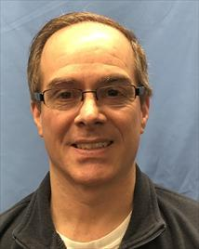

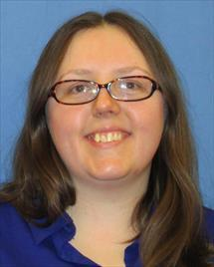
Our Team
Todd Fecto
Adam Rolain
Jessica Miller-Nims

Slide 3
Cool Space App:
Uses 3 NASA APIs to view:
Astronomy Picture of the Day
Todays
By date
By date range
Tech Transfer Patent news
Search patent info
Mars Rover pics
By date
And Rover

Slide 4
Let’s checkout space!

